Slide 1
TÜV Rheinland
Project Virtual Keyboard
Using a C64 without touching it!

Slide 2
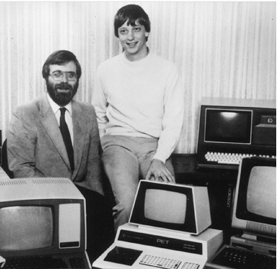


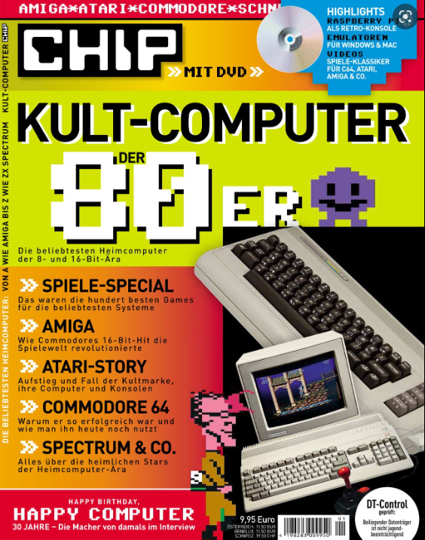

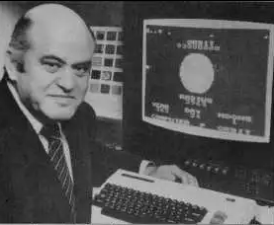
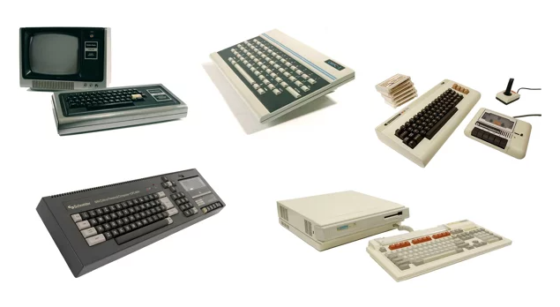
Virtual Keyboard
Homecomputer…

Slide 3
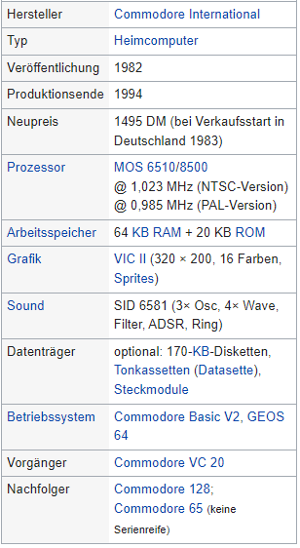
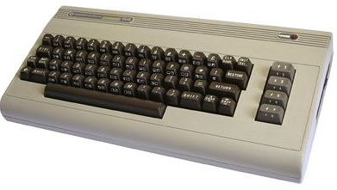
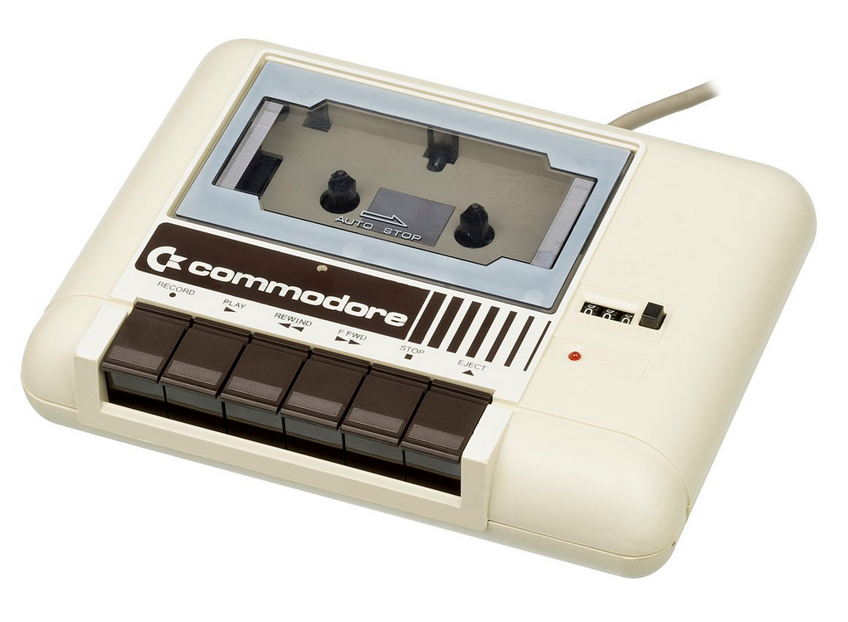
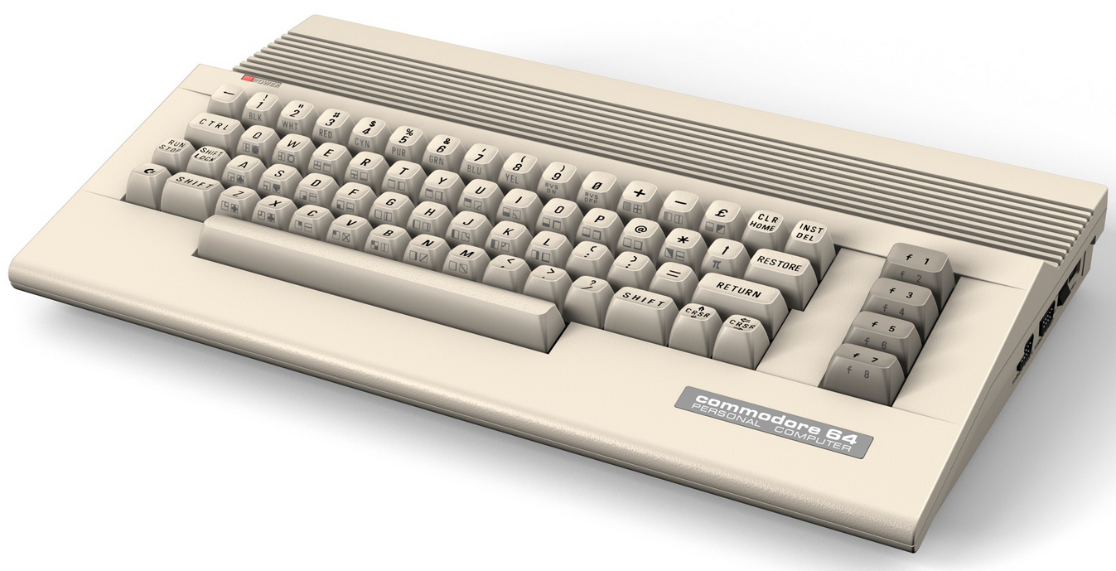
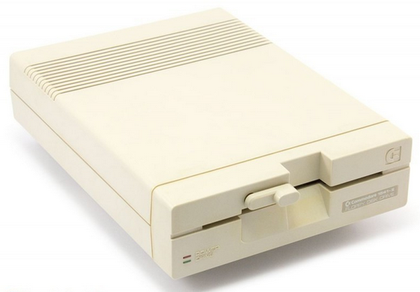
Virtual Keyboard
Homecomputer…

Slide 4
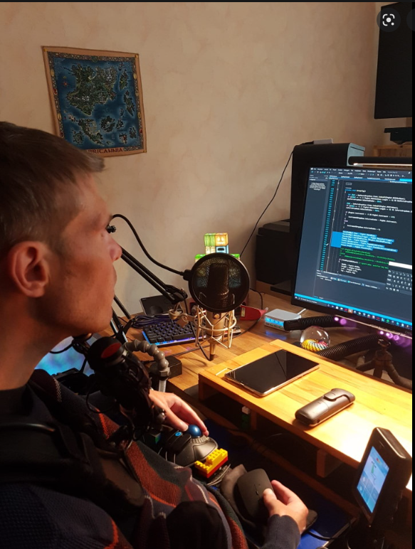
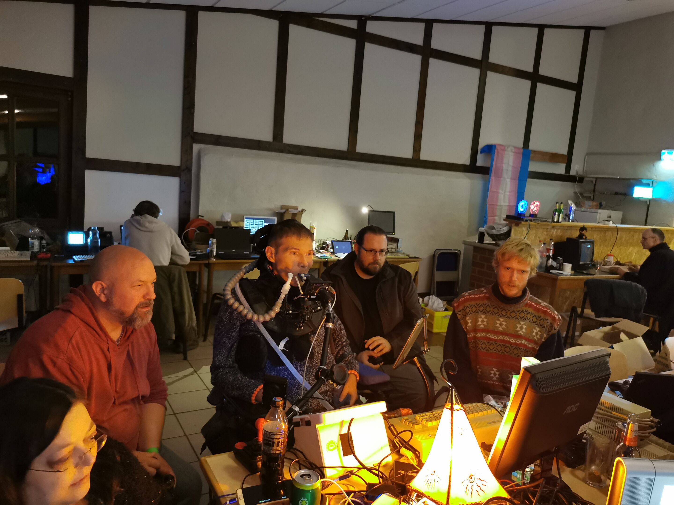
Virtual Keyboard
Retro Computer Events

Slide 5
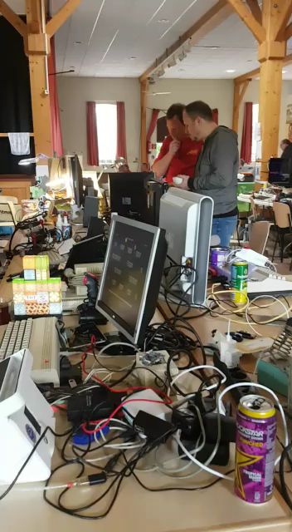
Virtual Keyboard
Using a C64 without touching it

Slide 6
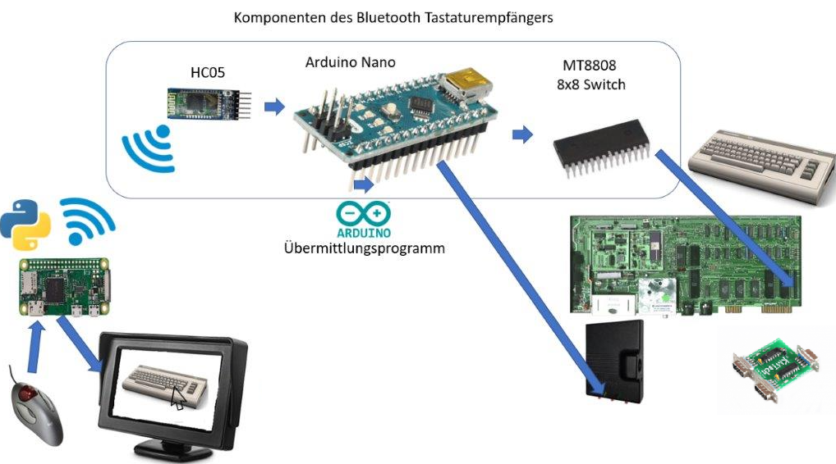
Virtual Keyboard
Idea

Slide 7
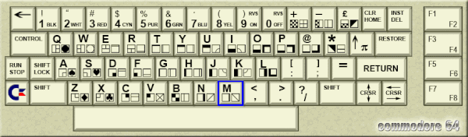
Virtual Keyboard
Keyboard layout

Slide 8
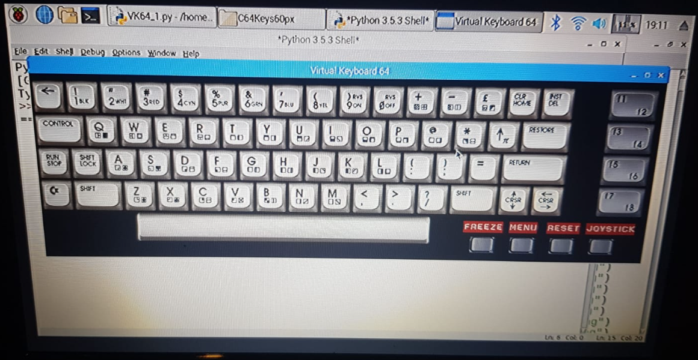
Virtual Keyboard
Prototyping…

Slide 9
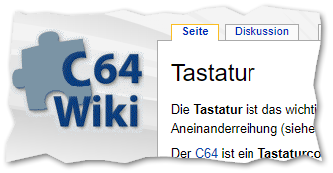
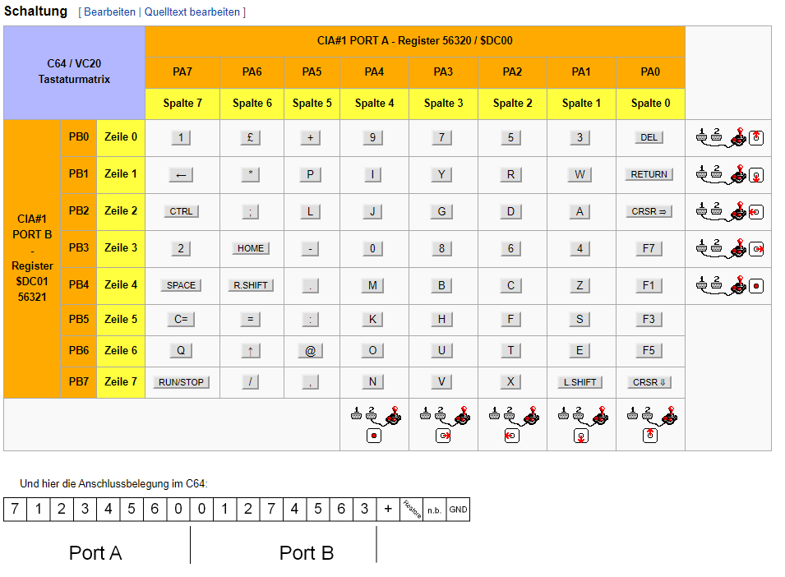
Virtual Keyboard
Keyboard Layout

Slide 10
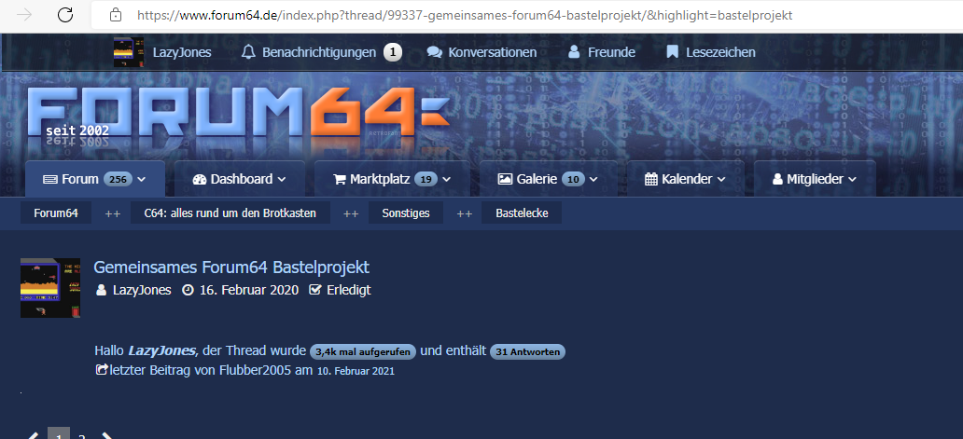
Virtual Keyboard
Community
https://www.forum64.de/index.php?thread/99337-gemeinsames-forum64-bastelprojekt/&highlight=bastelprojekt

Slide 11
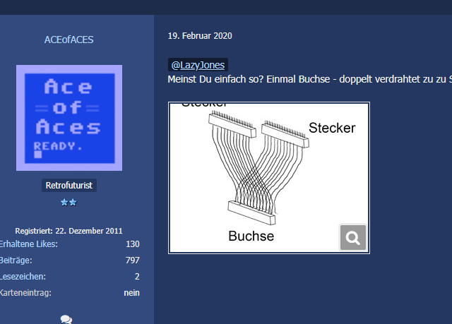
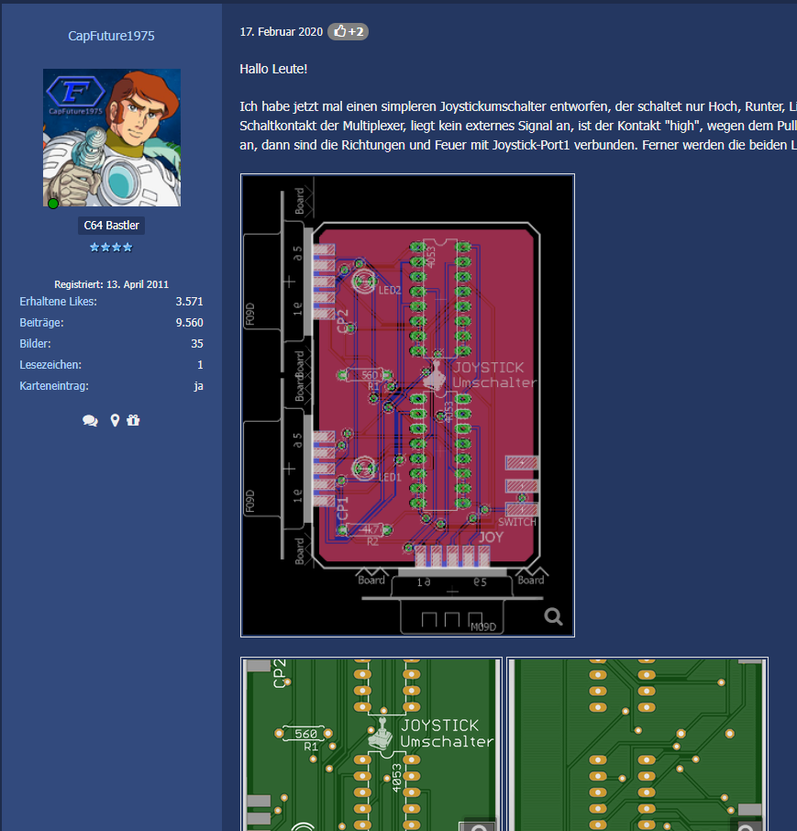
Virtual Keyboard
Community
Joystick switch

